Slide 1
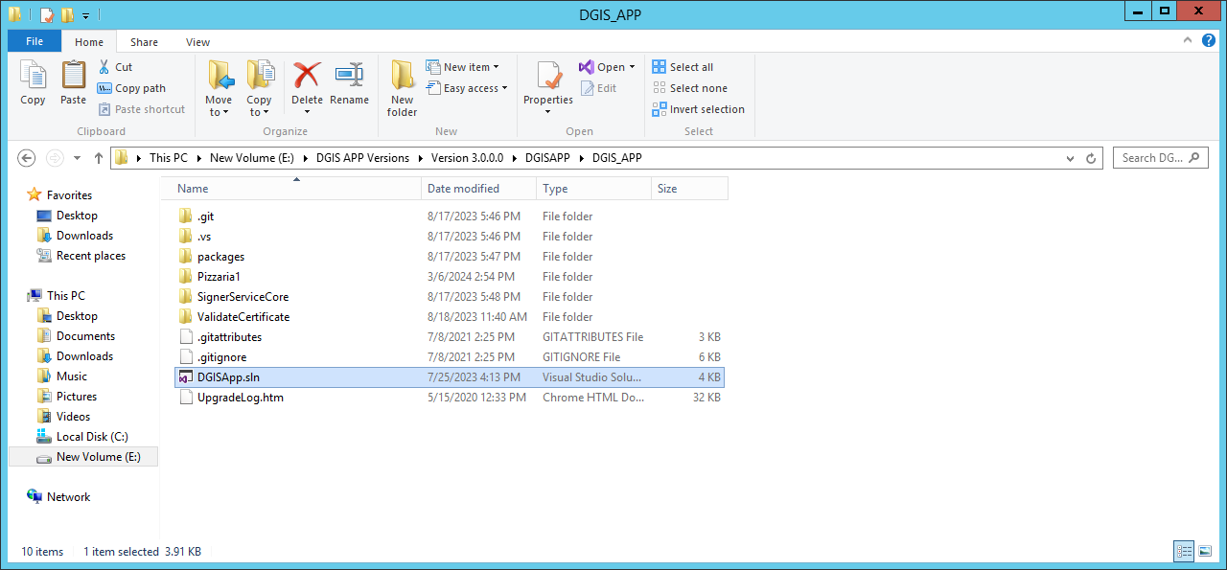
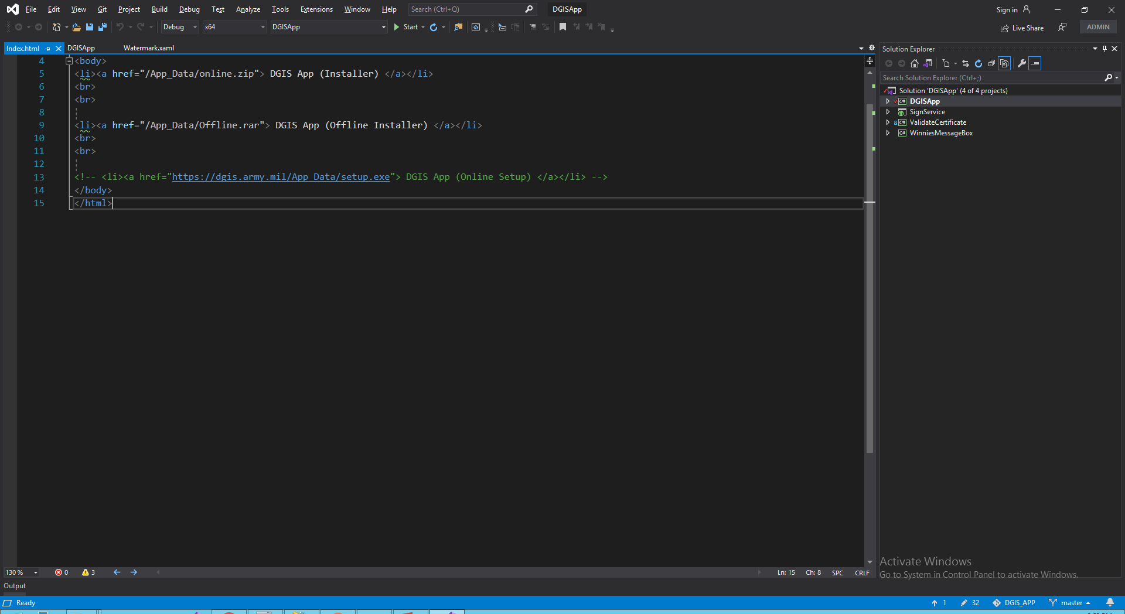
Open Project file of DGIS_App

Slide 2
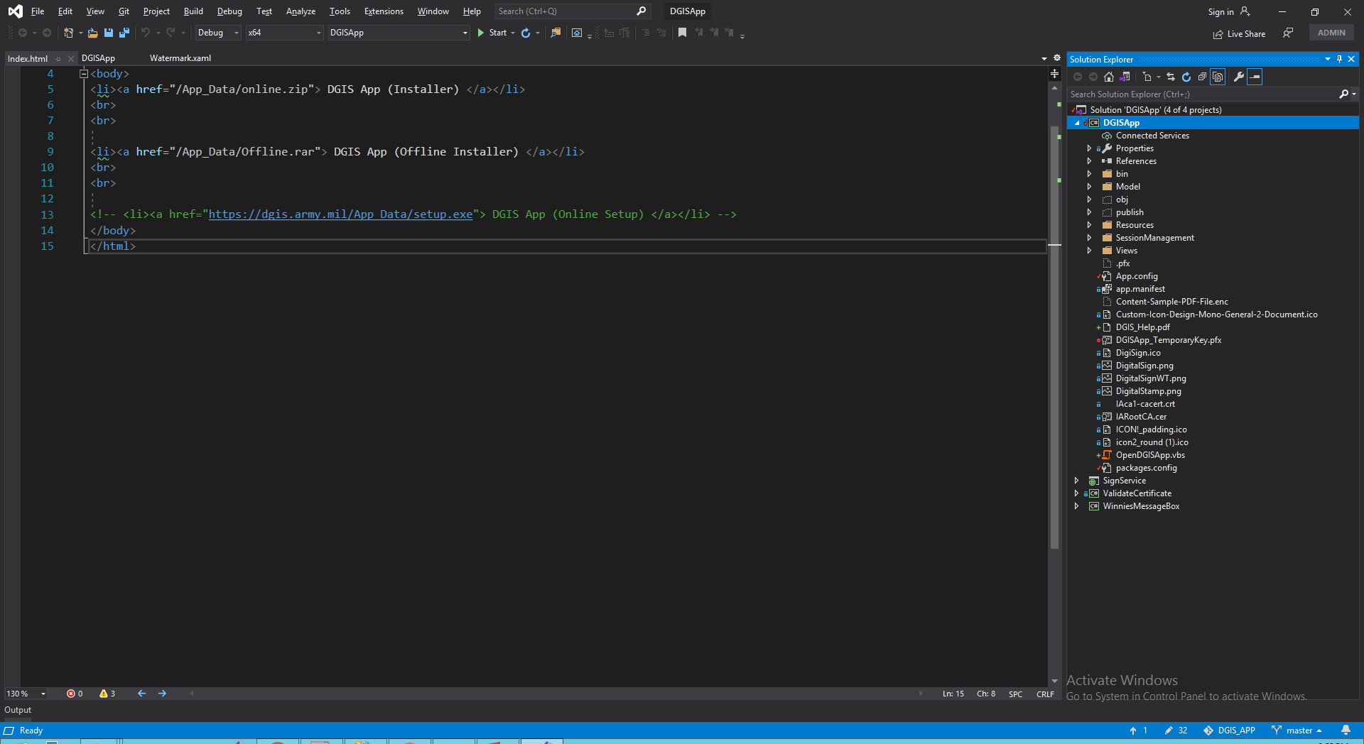
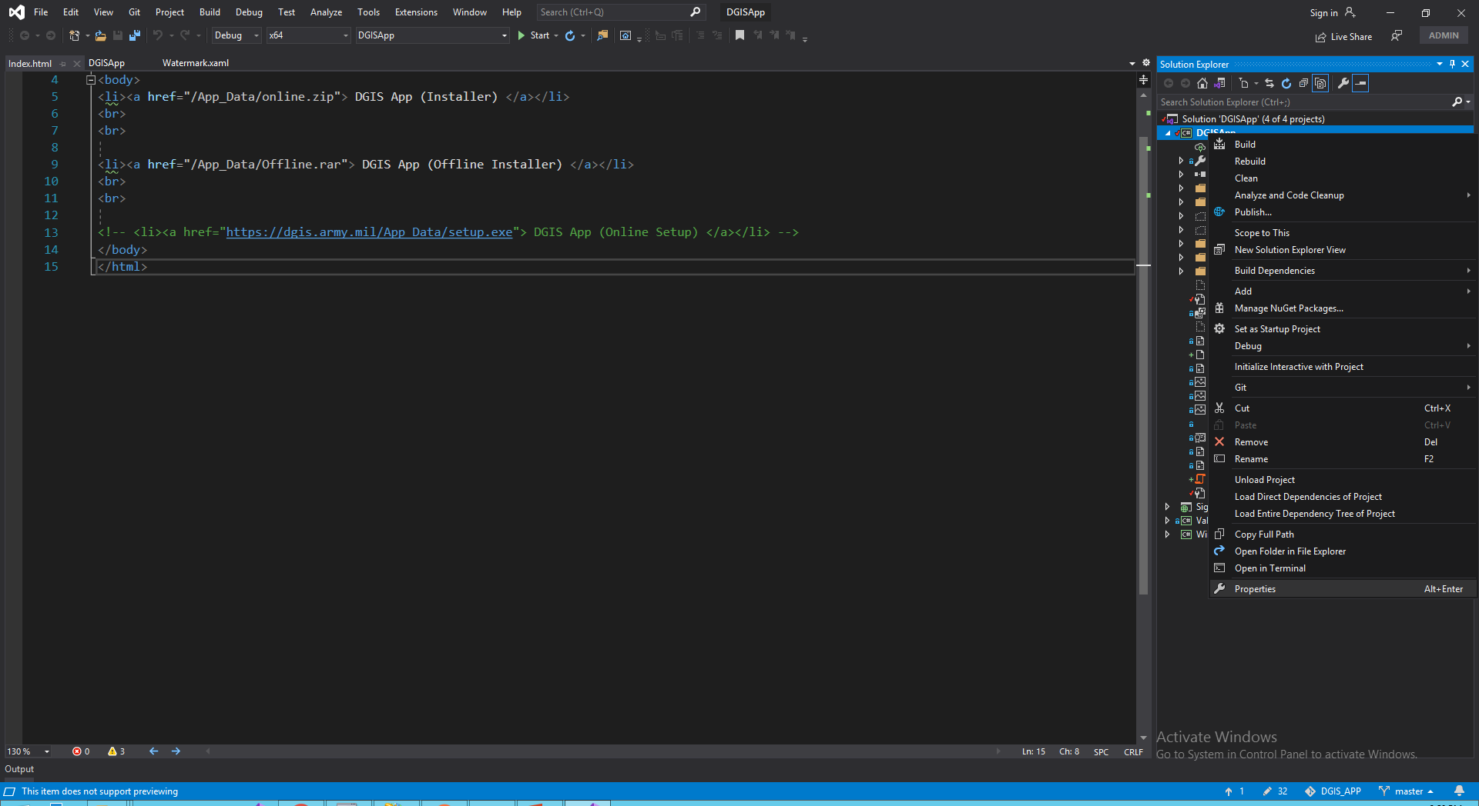
Delete DGISApp_TemporaryKey.Pfx
Go to properties of DGISApp by Right click

Slide 3
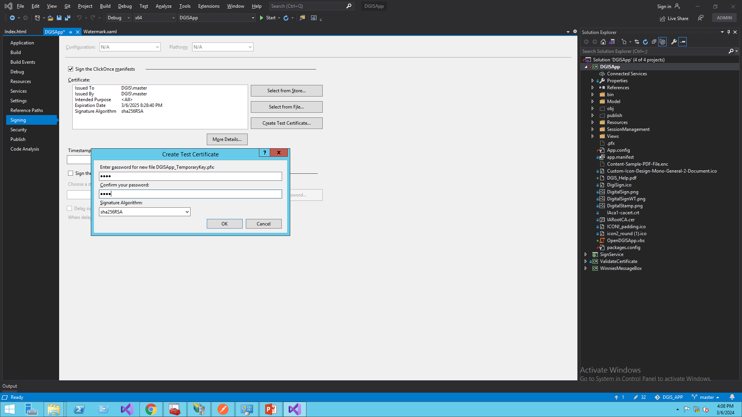
Click on Signing then click on Create Test Certificate and type password (any text password) and click on OK button for create new certificate and save by Ctrl + S

Slide 4
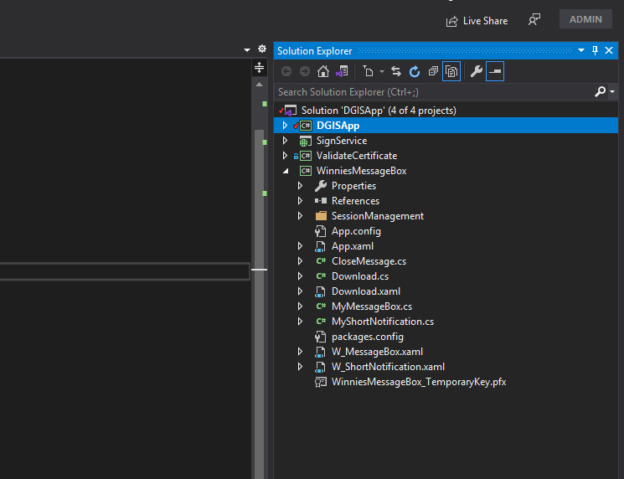
Delete WinniesMessageBox_Temporary.Pfx and same process for create new certificate as above.

Slide 5
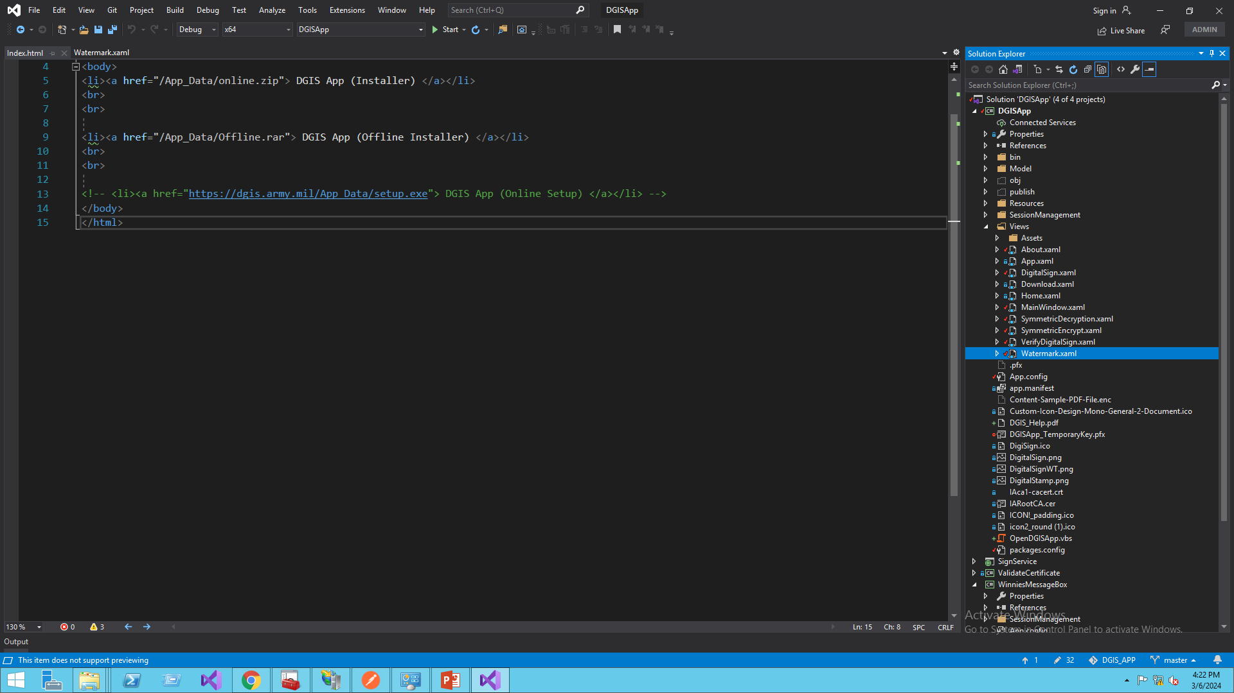
Now open *.xaml file where we want to changes.

Slide 6
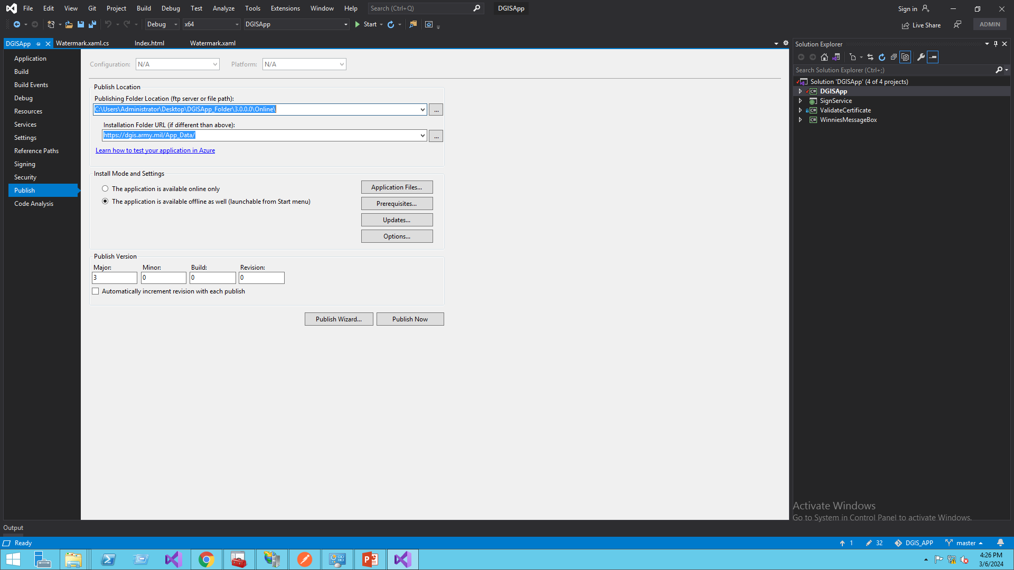
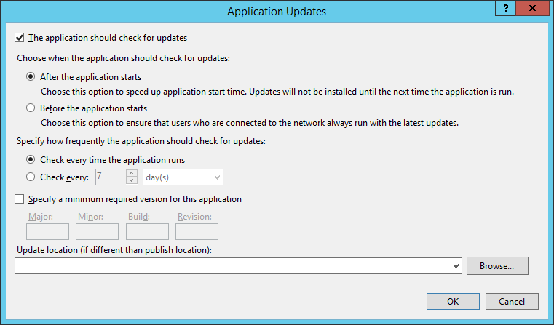
After updation publish the main project file with these parameter for Online DGIS App.
Enter version here

Slide 7
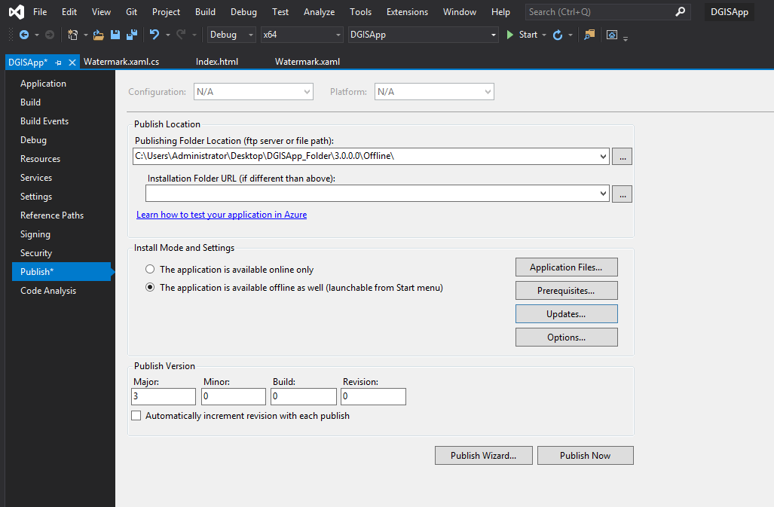
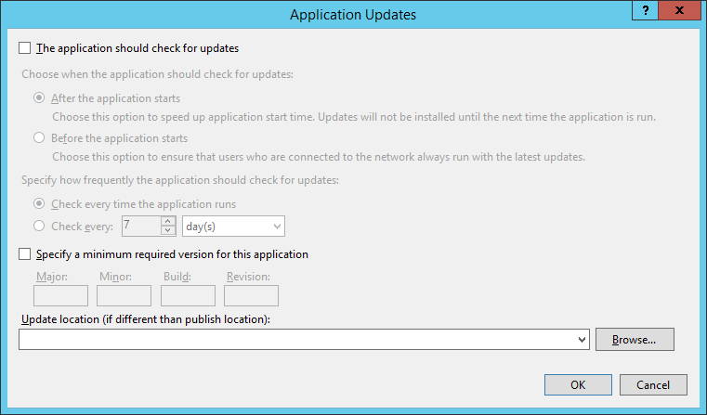
After updation publish the main project file with these parameter for Offline DGIS App.

Slide 8
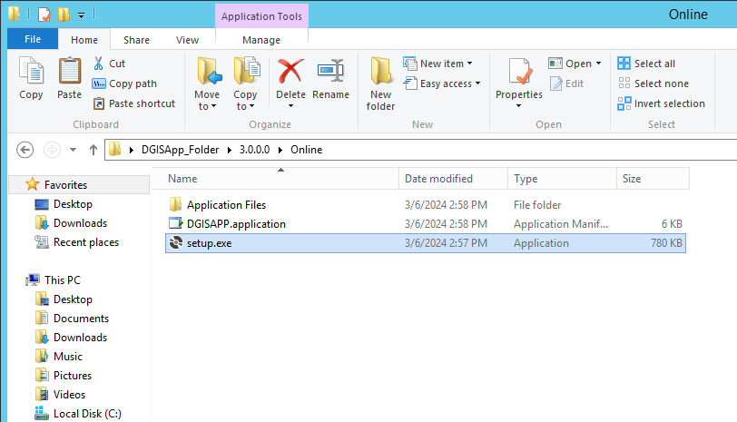
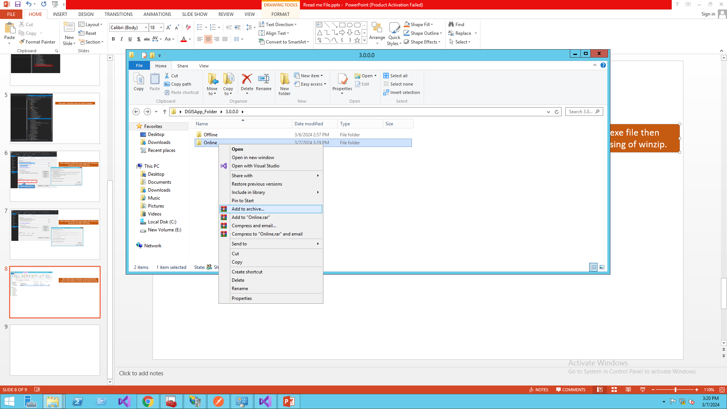
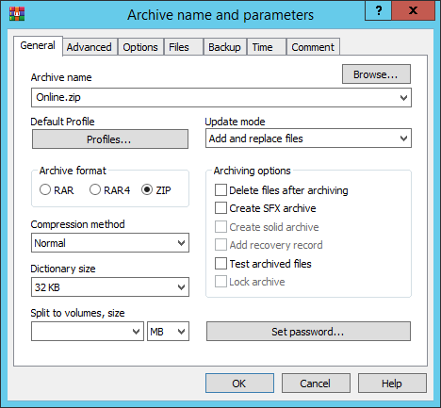
Open online folder and delete setup.exe file then convert online folder to online.zip by using of winrar.

Slide 9
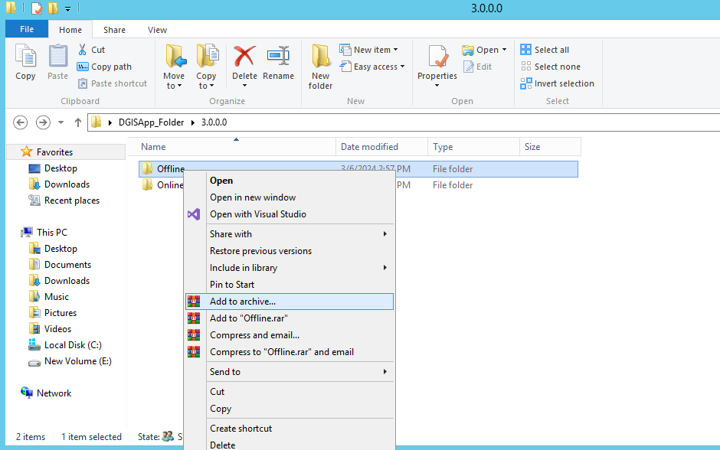
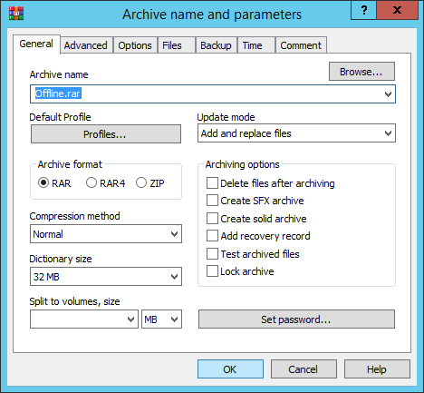
Convert offline folder to offline.rar by using of winrar without delete any file.

Slide 10
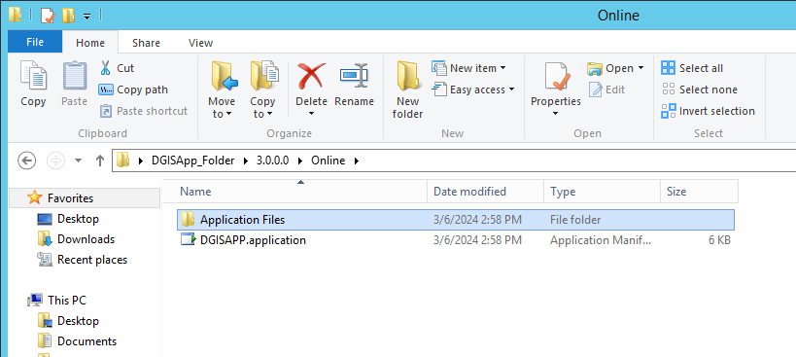
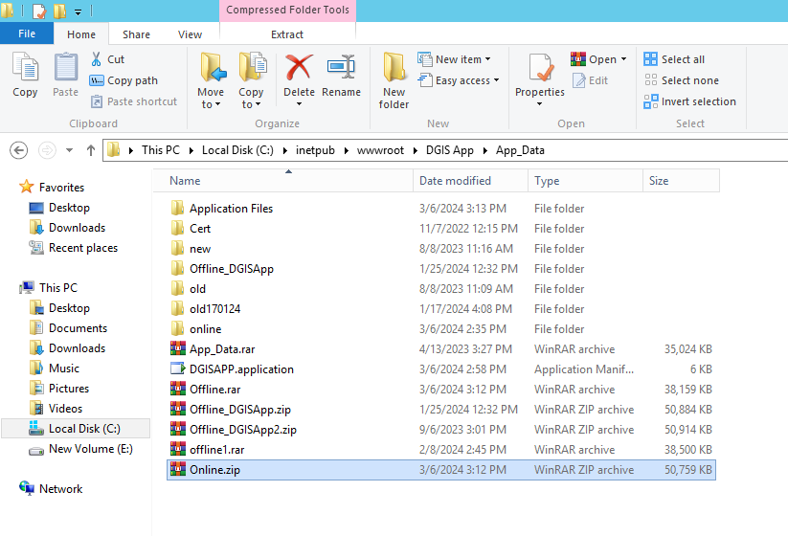
Copy Application files (folder) and DGISAPP.application file from online folder and replace to App_data folder (this folder is located in root folder where we publish site).
Copy and replace online.zip and offline.rar in this location also.

Slide 11
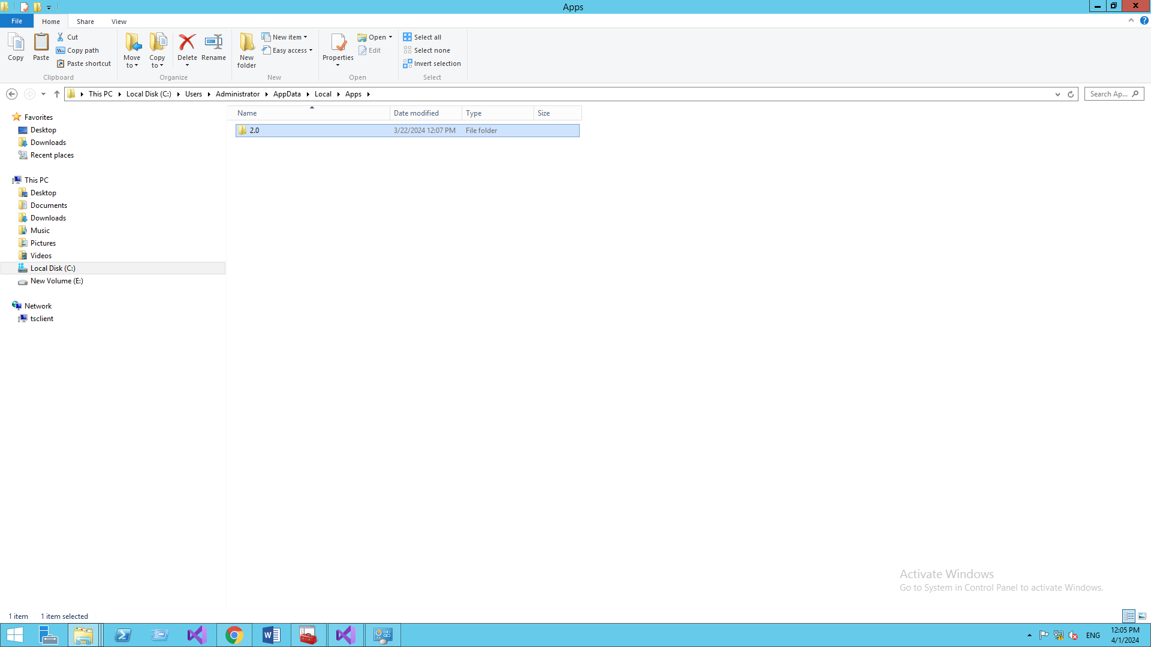

Slide 12
